Slide 1
.Net e il metaverso

Slide 3

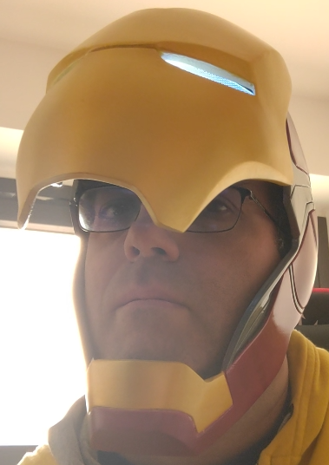
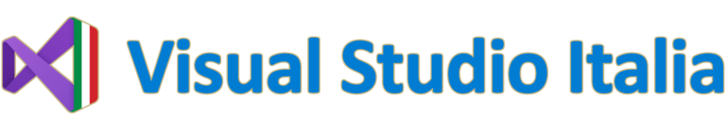
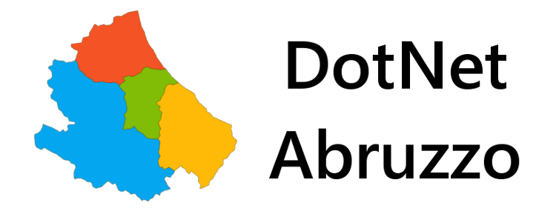

Alessio Iafrate
Freelance developer – Microsof MVP
alessioiafrate@hotmail.com
alessio-iafrate
@alessioiafrate

Slide 4
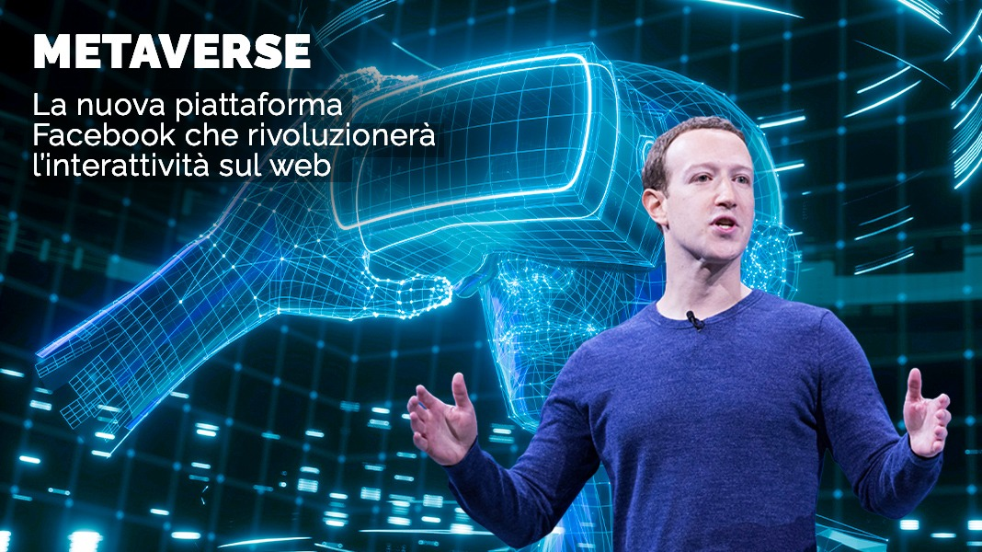
Notes:
28 ottobre 2021

Slide 5
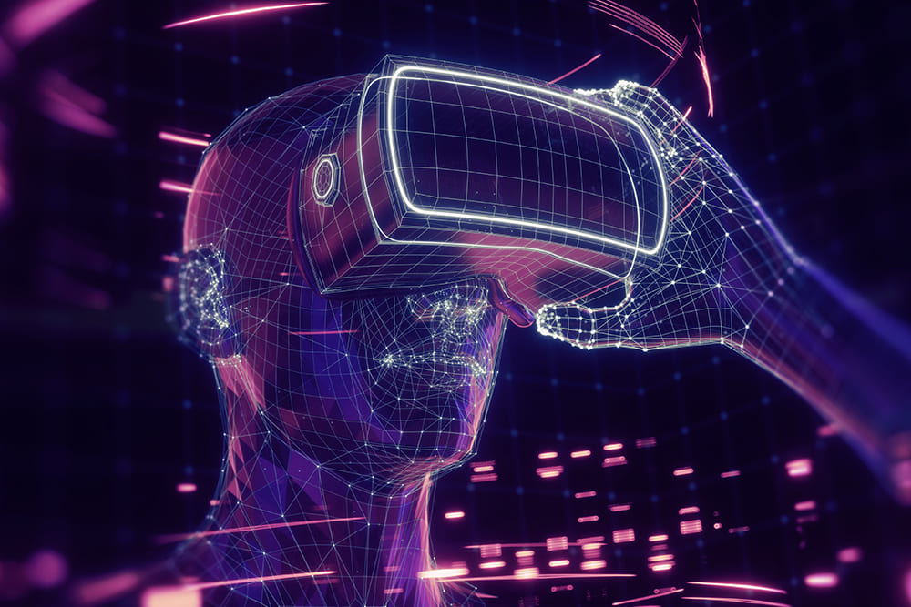
Metaverso (in inglese Metaverse) è un termine coniato da Neal Stephenson in Snow Crash (1992), libro di fantascienza
cyberpunk, descritto come una sorta di realtà virtuale condivisa tramite internet, dove si è rappresentati in tre dimensioni attraverso il proprio avatar.
Notes:
Metaverso (in inglese Metaverse) è un termine coniato da Neal Stephenson in Snow Crash (1992), libro di fantascienza cyberpunk, descritto come una sorta di realtà virtuale condivisa tramite internet, dove si è rappresentati in tre dimensioni attraverso il proprio avatar.

Slide 6
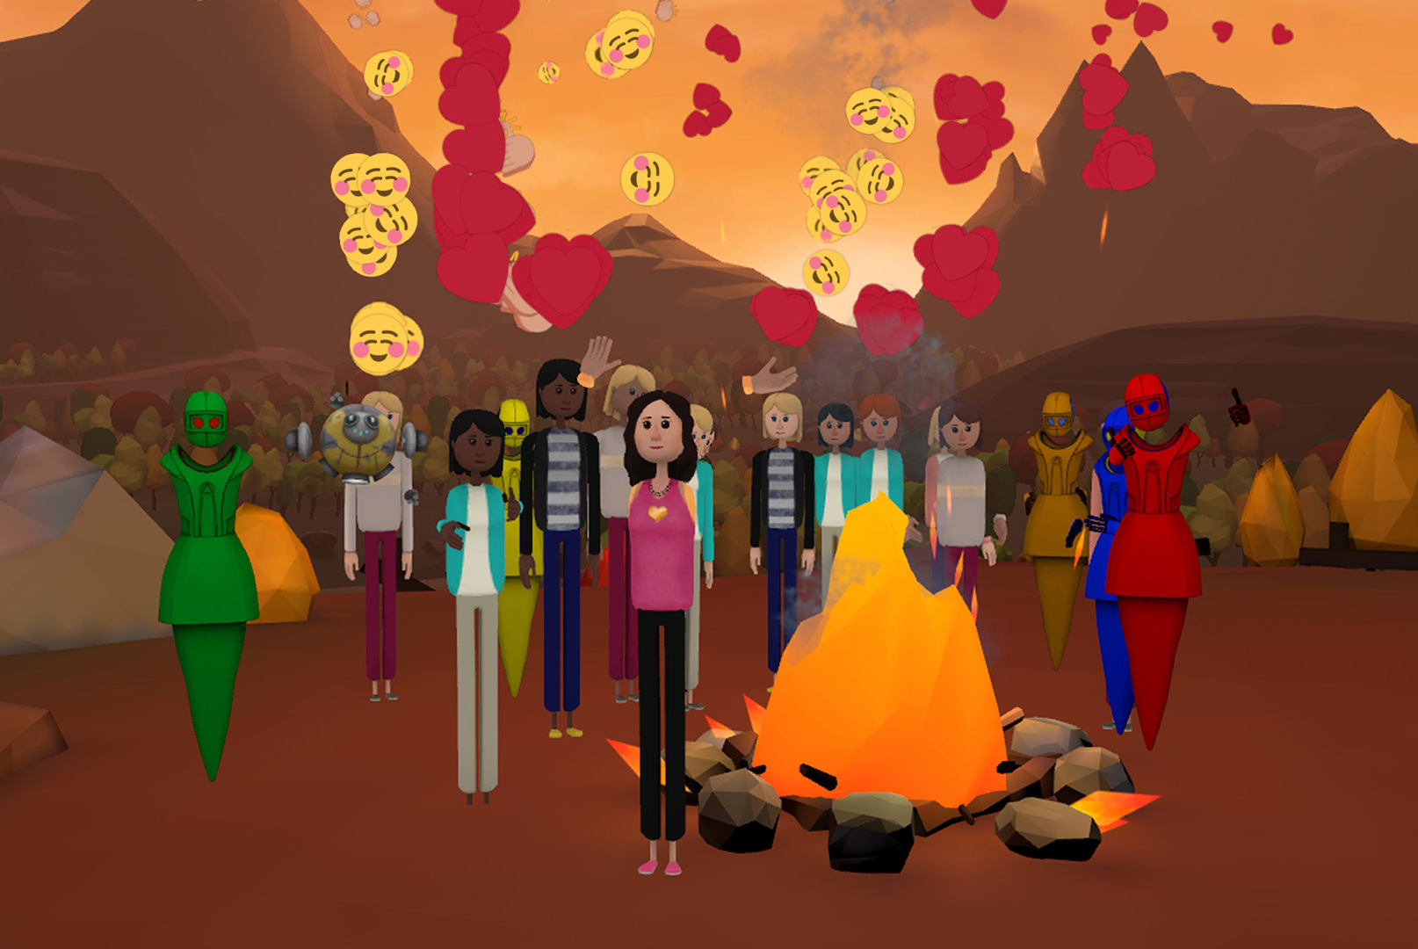
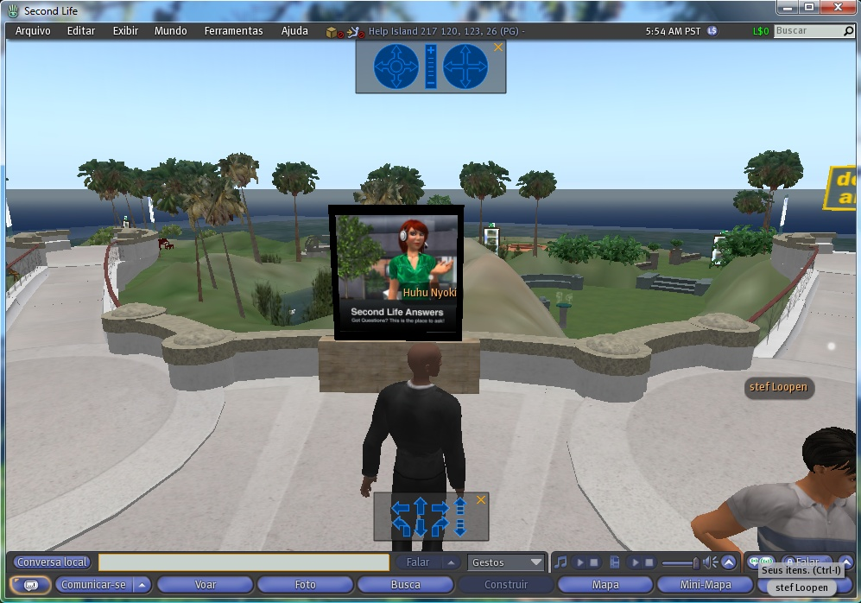
Tutto già visto?
Notes:
Second life , altspace vr

Slide 7
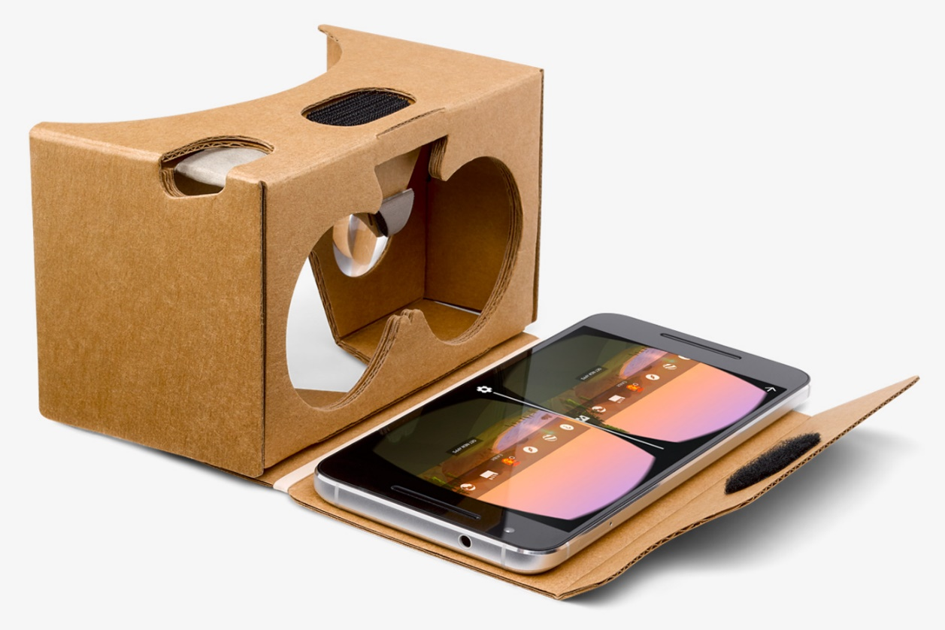
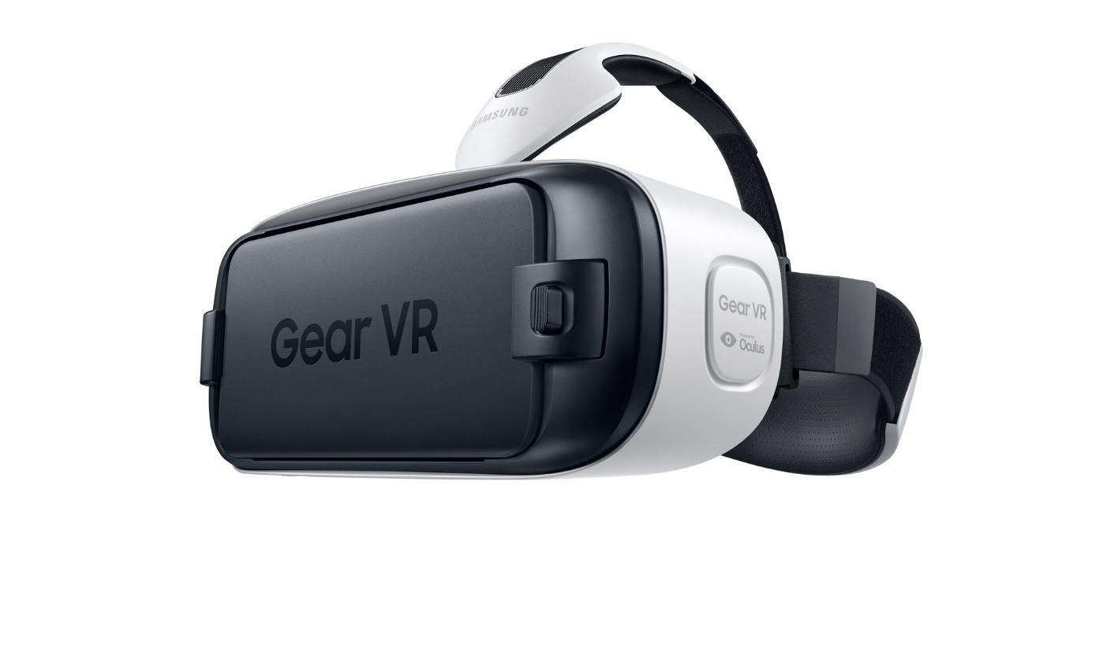
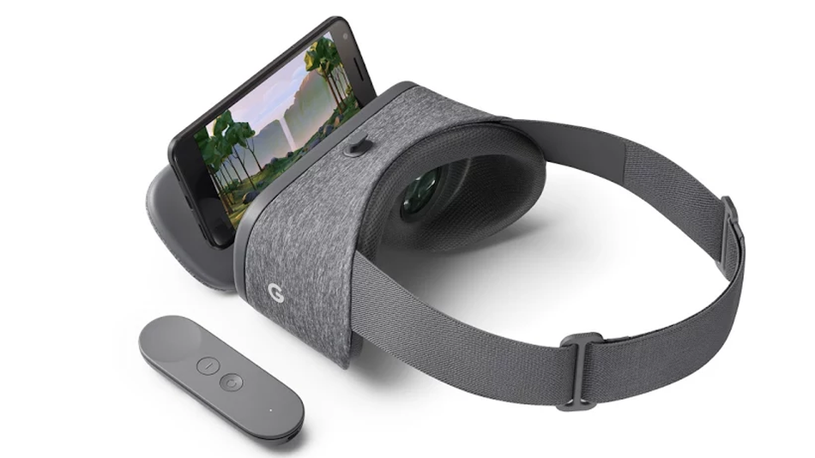
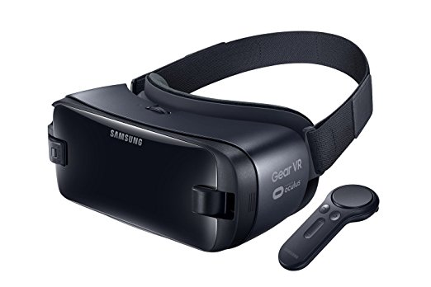

Slide 8
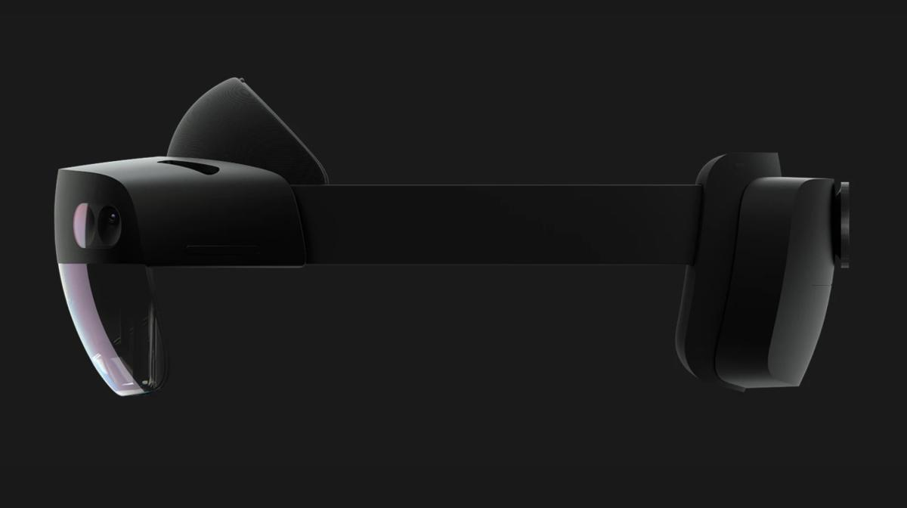

Slide 9
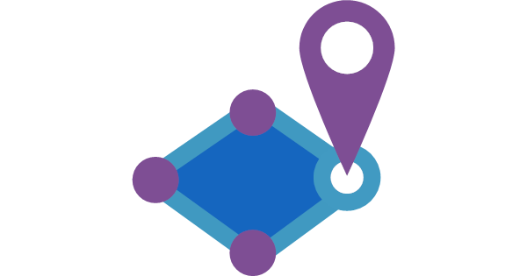

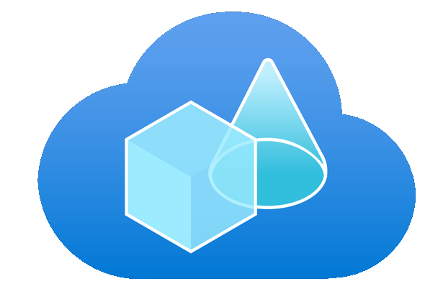
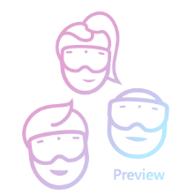
Azure Metaverse
 | Android | Ios | Hololens | Microsoft Teams | Windows Desktop
Spatial Ancors | X | X | X
Object Ancors |  |  | X
Remote rendering |  |  | X (v2) |  | X
Microsoft Mesh | X | X | X | X | X

Slide 10
Spatial Anchors
Notes:
Abstract concept → Examples and scenarios we see with our customers
HL since 2015 → Dozens of apps / use cases
Due to NDA generalized use cases we see commonly

Slide 11
Spatial Anchor?
y
x
z
Notes:
Own coord system for location in real-world
A common frame of reference to place digital content in the same physical location where it stays at the same position and orientation relative to the real-world environment.

Slide 12

Spatial Anchor?
y
x
z
Notes:
Location in real-world ensures virtual content stays at the same pos/orient even if you move
Anchor is not the content, just a real-world location where content can be anchored
HoloLens, ARKit, ARCore and Magic Leap (PCF)
A common frame of reference to place digital content in the same physical location where it stays at the same position and orientation relative to the real-world environment.

Slide 13
Cloud Spatial Anchor
Azure Spatial Anchors
y
y
x
x
z
z
y
x
z
Notes:
What is a Cloud Spatial Anchor - Why Cloud?
Normalizes different devices anchors/mappings
Multiple users. sharing across devices with persistence
A common frame of reference for enabling multiple users to place digital content in the same physical location where it is persisted and can be seen on different devices at the same position and orientation relative to the real-world environment.

Slide 14
Cloud Spatial Anchor
Azure Spatial Anchors
y
x
z
y
x
z
… one week later
Notes:
Persistence
Hot research topic, Startups as well as big players
ASA is the only implementation that provides persisted, x-plat, shared anchors
→ Paris later tech details
Here more examples: shared, x-plat + persistence
A common frame of reference for enabling multiple users to place digital content in the same physical location where it is persisted and can be seen on different devices at the same position and orientation relative to the real-world environment.

Slide 15


Persistent virtual content
Azure Spatial Anchors
Client
iOS – Swift, ARKit, SceneKit
Android – Java, ARCore, SceneForm
Mobile
Sharing Service
HoloLens
Azure
App Service
Azure Cosmos DB
Notes:
Abstract concept → Examples and scenarios we see with our customers
HL since 2015 → Dozens of apps / use cases

Slide 16

Persistent virtual content
Azure Spatial Anchors
Client
Initialize session
Create anchor
Locate anchors
Mobile
1. Save anchor
2. Get anchor ID back
5. Locate anchors by ID
6. Get anchors back
Sharing
Service
HoloLens
3. Save anchor ID in database
4. Get IDs from database
You write this yourself!
Notes:
Abstract concept → Examples and scenarios we see with our customers
HL since 2015 → Dozens of apps / use cases
Due to NDA generalized use cases we see commonly

Slide 17
Coarse relocalization
 | HoloLens | Android | iOS
GPS | No | Sì | Sì
Wi-Fi | Sì | Sì | Sì
Fari BLE | Sì | Sì | Sì

Slide 18
Demo
Notes:
Abstract concept → Examples and scenarios we see with our customers
HL since 2015 → Dozens of apps / use cases
Due to NDA generalized use cases we see commonly

Slide 19
Business Area
Notes:
Abstract concept → Examples and scenarios we see with our customers
HL since 2015 → Dozens of apps / use cases
Due to NDA generalized use cases we see commonly

Slide 20
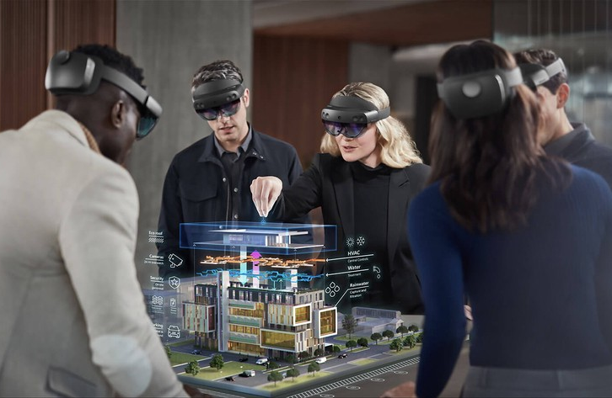
Persistent multi-user virtual content
01
Collaborative design reviews

Slide 21
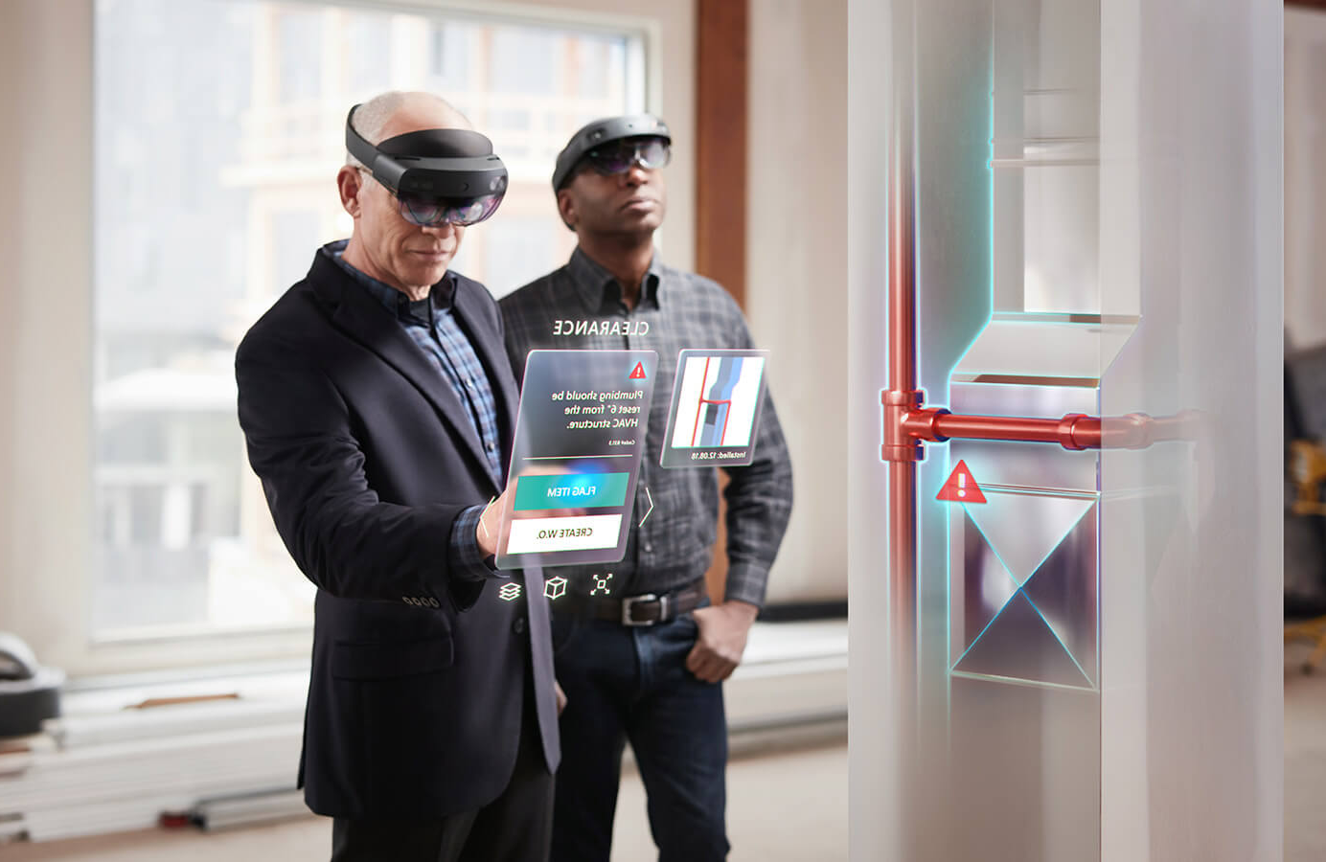
Persistent multi-user virtual content
01
Collaborative design reviews
02
Real-time IoT digital twin data on actual equipment

Slide 22
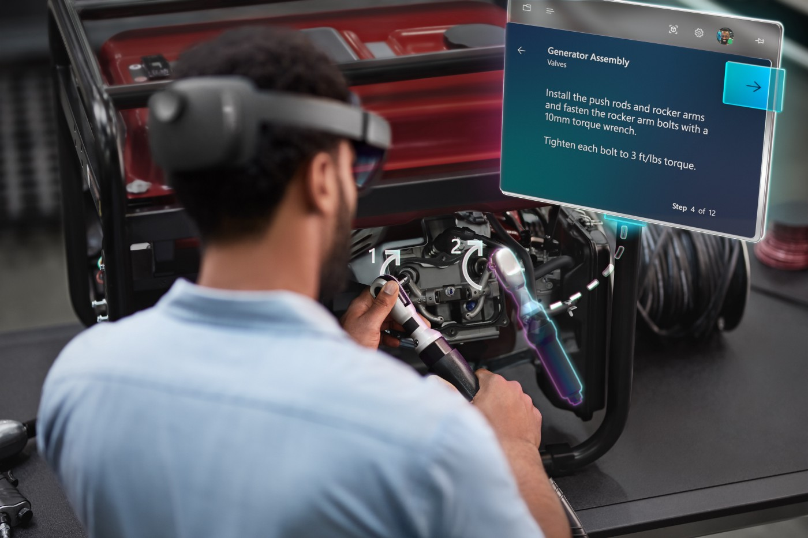
Persistent multi-user virtual content
01
Collaborative design reviews
02
Real-time IoT digital twin data on actual equipment
03
Training guidance

Slide 23
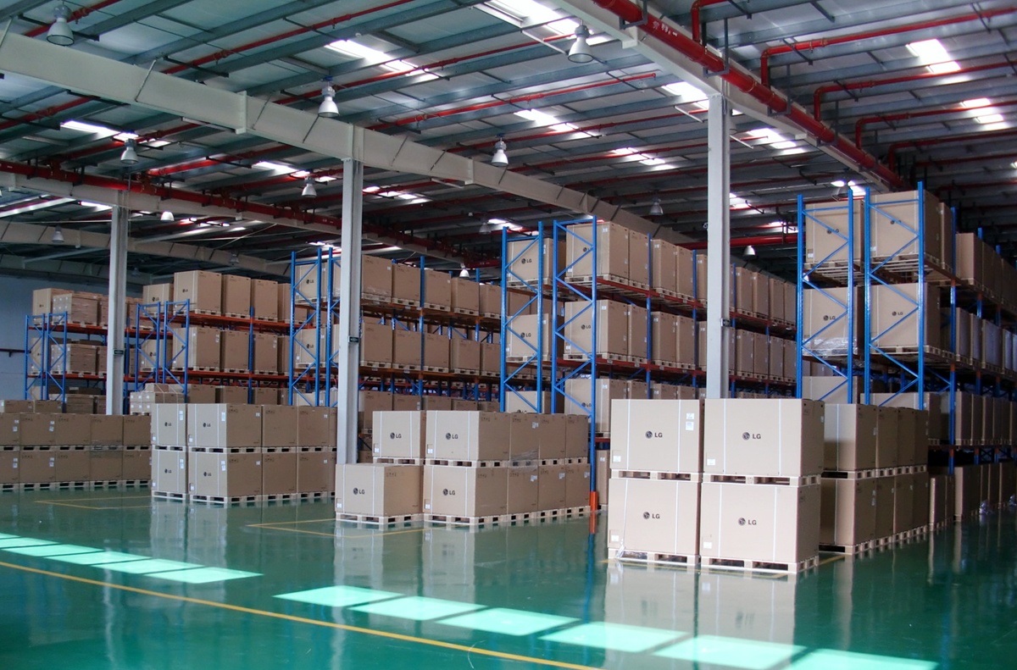
Persistent multi-user virtual content
01
Collaborative design reviews
02
Real-time IoT digital twin data on actual equipment
03
Training guidance
04
Wayfinding

Slide 24
Consumer Area
Notes:
Abstract concept → Examples and scenarios we see with our customers
HL since 2015 → Dozens of apps / use cases
Due to NDA generalized use cases we see commonly

Slide 25
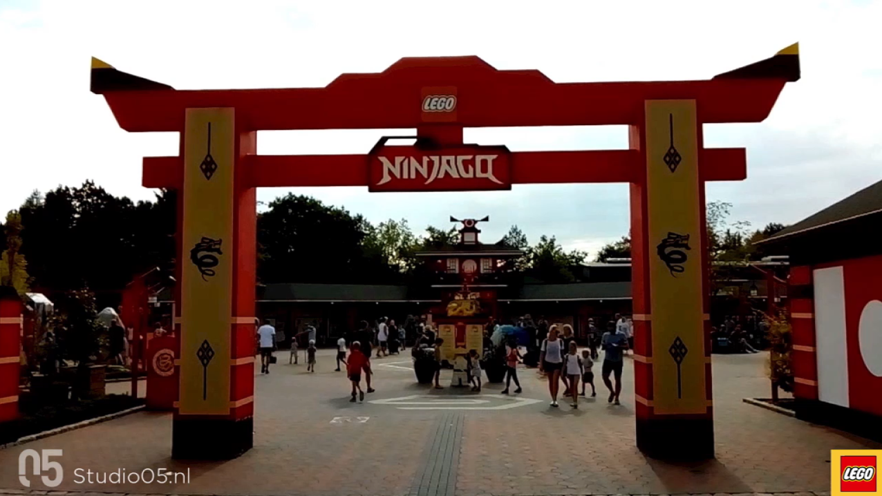
Persistent multi-user virtual content
01
Wayfinding

Slide 26
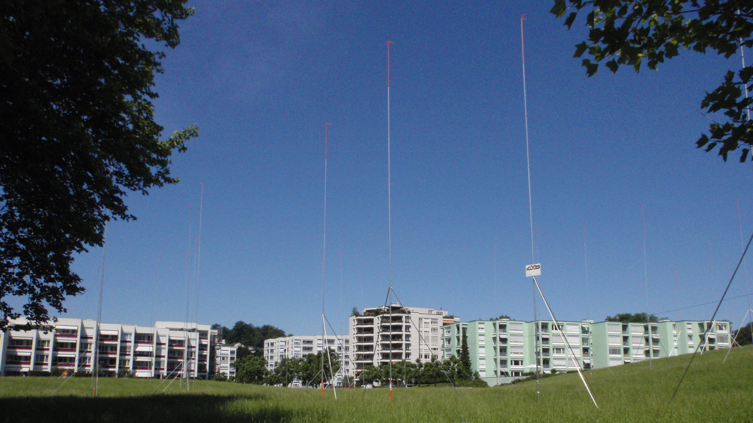
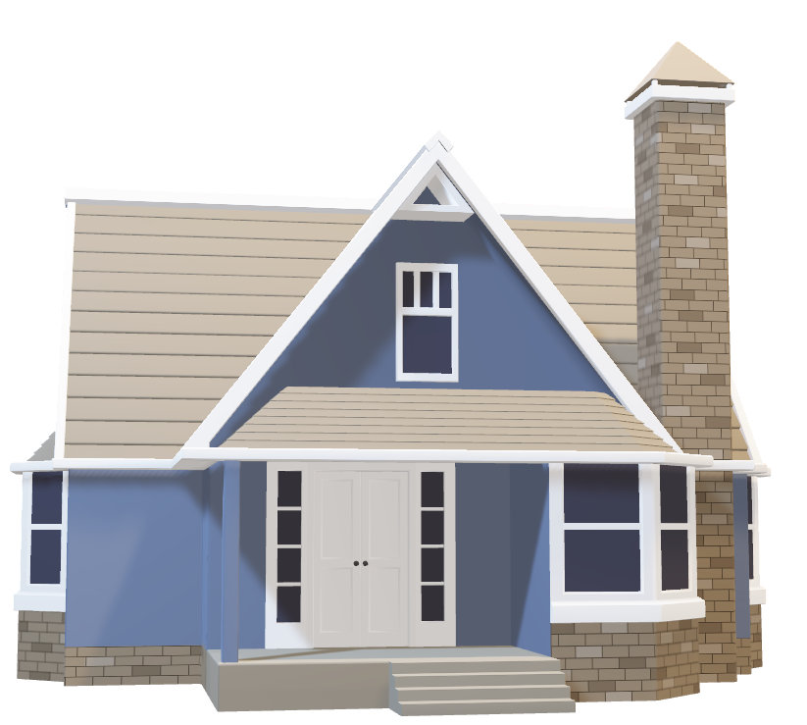
Persistent multi-user virtual content
01
Wayfinding
02
Static contents

Slide 27
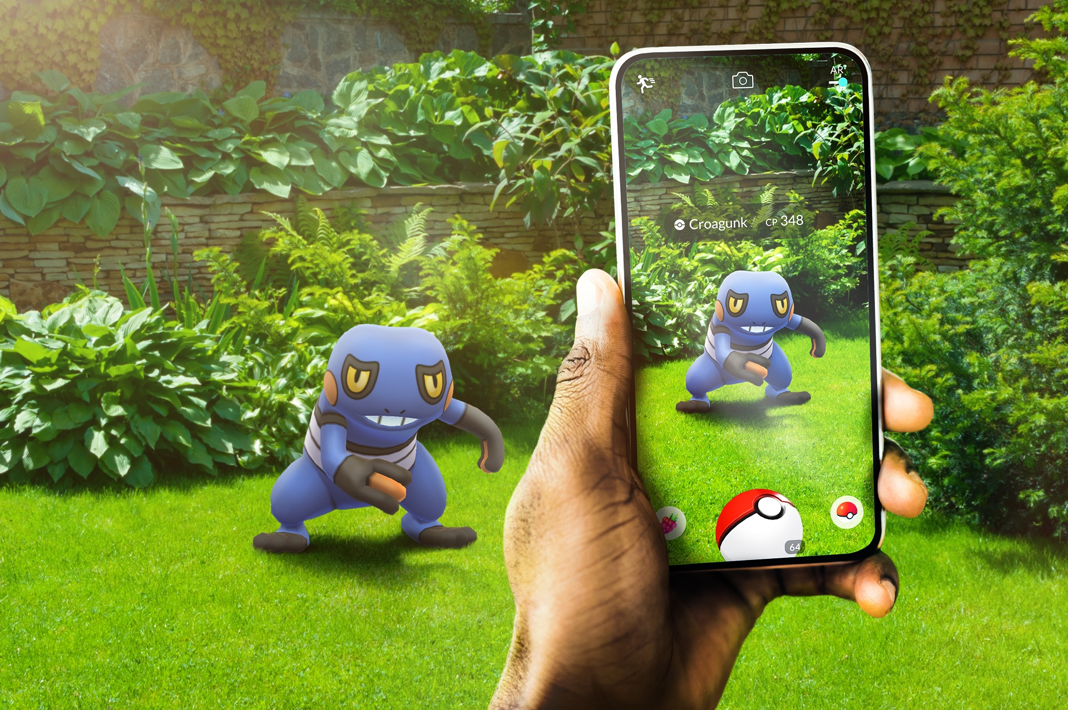
Persistent multi-user virtual content
01
Wayfinding
02
Static contents
03
Games

Slide 28
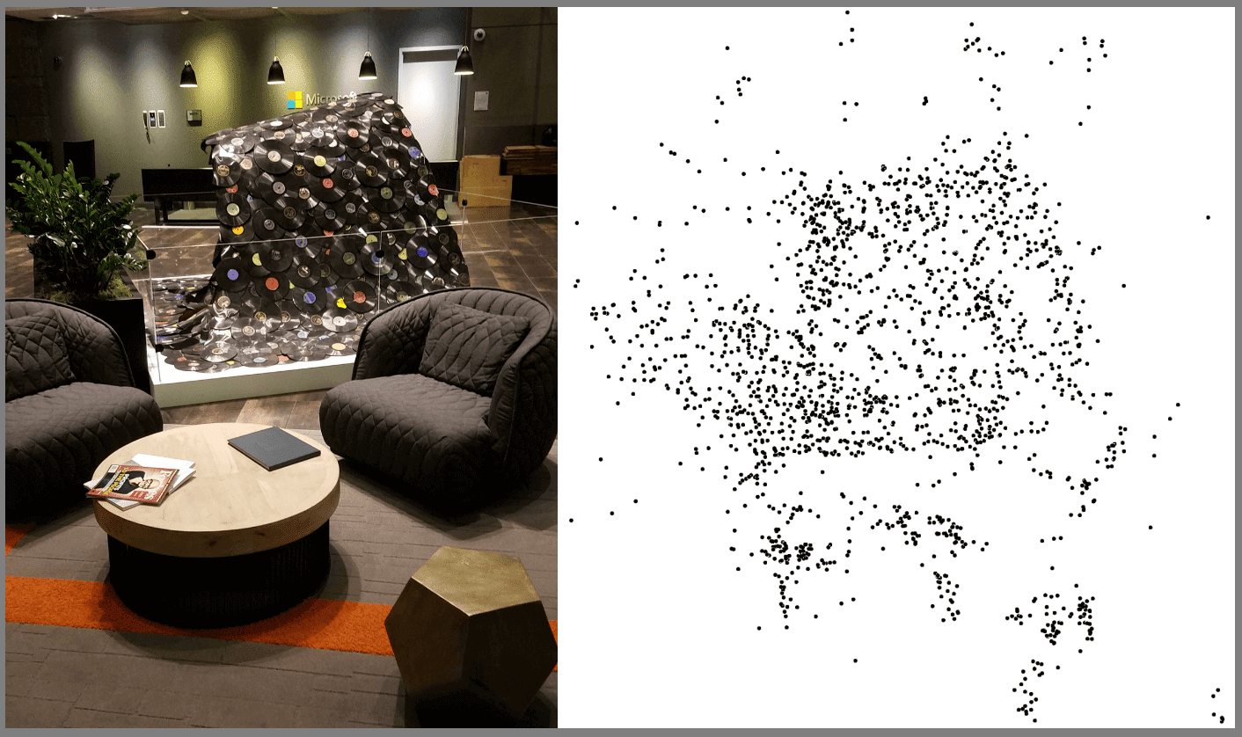
behind the scenes
Notes:
And this video is what Azure Spatial Anchors sees when it's looking at the lobby.
In green are feature points, which are distinguishing points in the real world. Your badge would be full of feature points because there are lots of high visual contrast.
In red are camera frames, which are the pictures we took with the camera from different points in space.
As you wave your phone around, we get more and more green feature points. When you place an anchor, it gets tied to those feature points. And when you look for an anchor, we use the feature points that we've collected to know where the anchor should be placed.
I want to note that all of this is done on the device, so no camera frames are leaving your device.

Slide 29
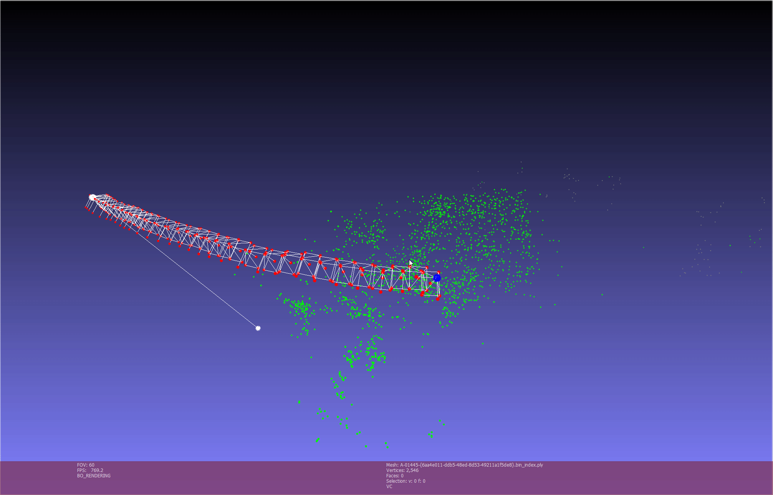
behind the scenes
Notes:
And this video is what Azure Spatial Anchors sees when it's looking at the lobby.
In green are feature points, which are distinguishing points in the real world. Your badge would be full of feature points because there are lots of high visual contrast.
In red are camera frames, which are the pictures we took with the camera from different points in space.
As you wave your phone around, we get more and more green feature points. When you place an anchor, it gets tied to those feature points. And when you look for an anchor, we use the feature points that we've collected to know where the anchor should be placed.
I want to note that all of this is done on the device, so no camera frames are leaving your device.

Slide 30



SDK
HoloLens
iOS (ARKit)
Android (ARCore)
Unity
C++/WinRT
Xamarin
Unity
Objective-C
Swift
Xamarin
Unity
Java
C++/NDK
Notes:
Support HL, iOS, Android. Can develop on Unity or write native apps.
All platforms are first class citizens. And our KPI matrix that considers all platforms, and their relationships to each other.
Today, we’re highlighting iOS Swift and Android Java. But you can also build for iOS and Android.

Slide 31
Pricing - West europe
Anchor Locate Requests (ALR) | Price/ALR/month
0-10,000 | Free
10,000+ | €0.021

Slide 32
PREVIEW Object Anchors
Notes:
Abstract concept → Examples and scenarios we see with our customers
HL since 2015 → Dozens of apps / use cases
Due to NDA generalized use cases we see commonly

Slide 33
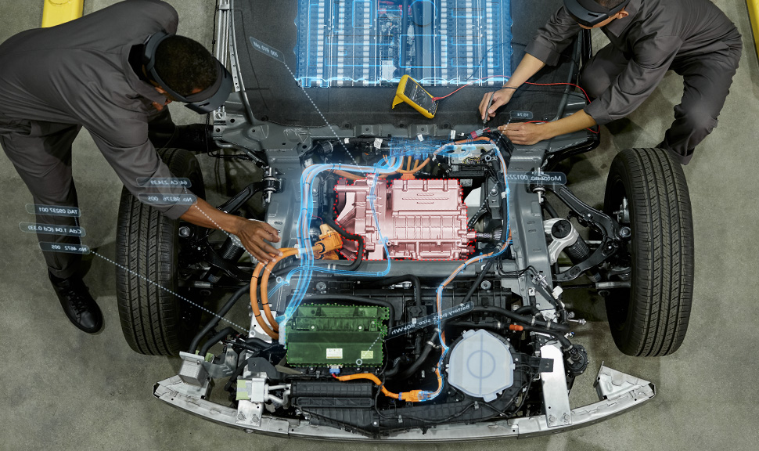
PREVIEW Object Anchors
01
Training

Slide 34
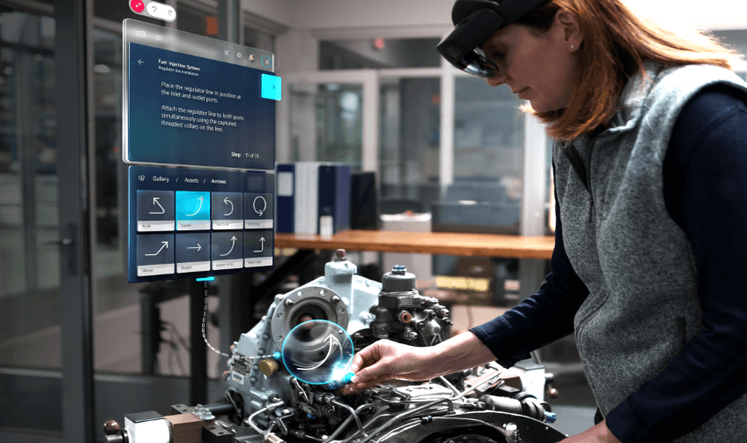
PREVIEW Object Anchors
01
Trainig
02
Task Guidance

Slide 35
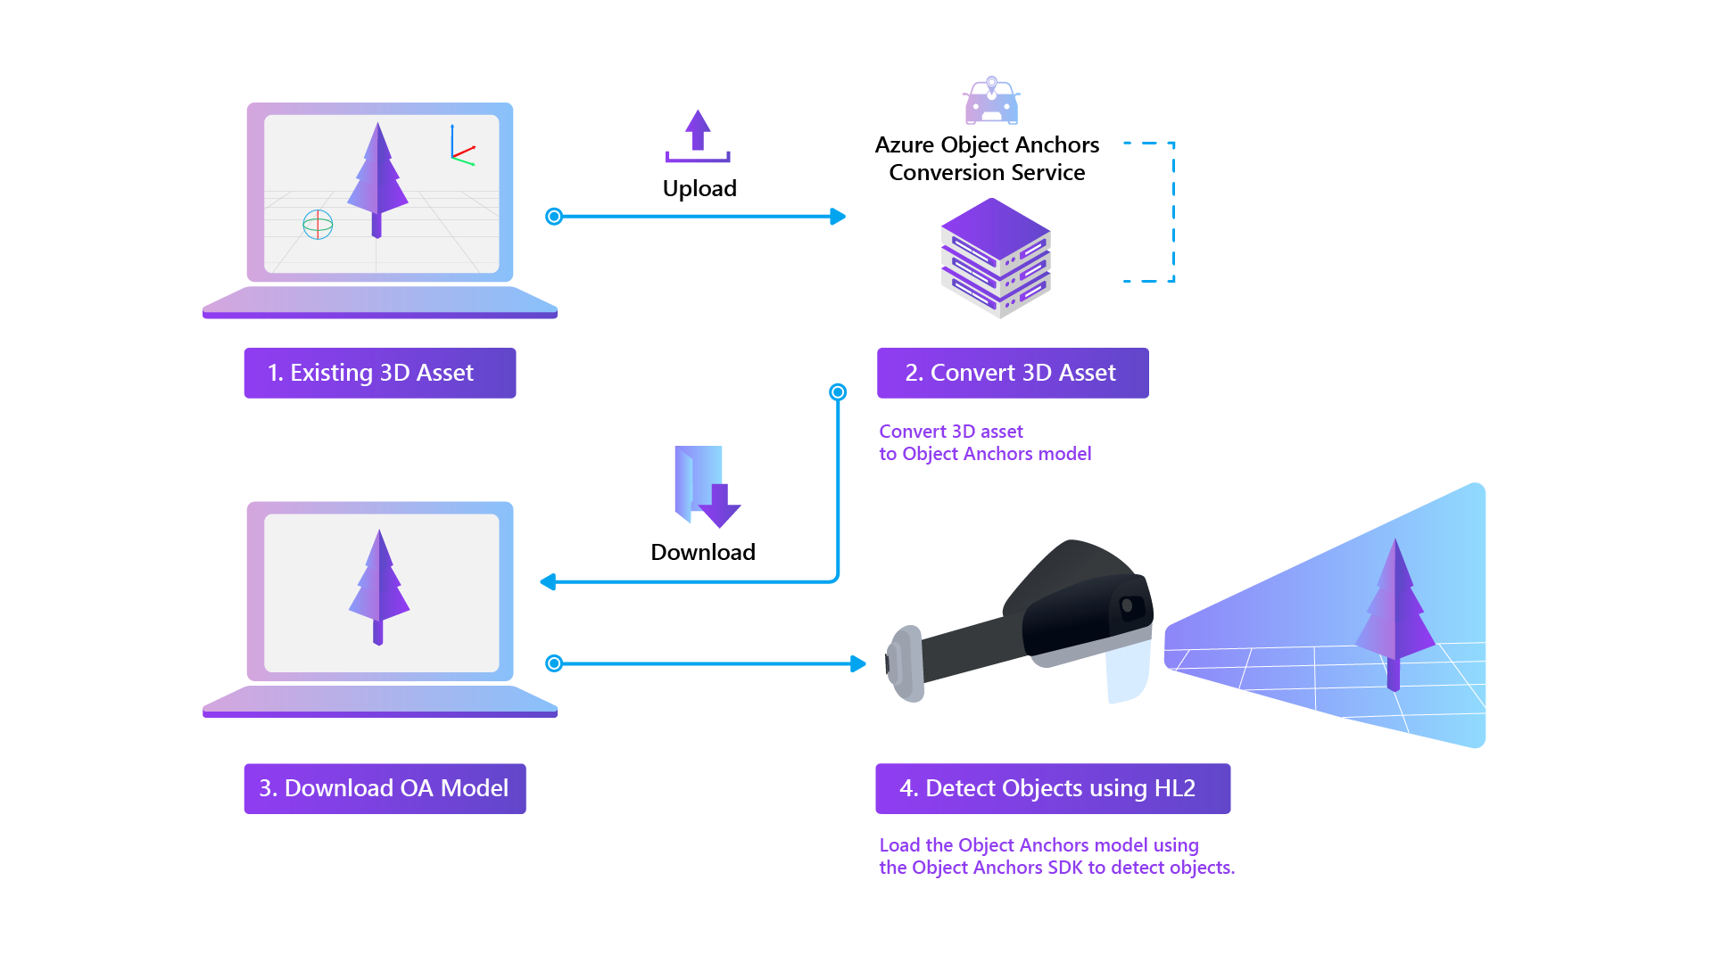
Flusso

Slide 36
Demo
Notes:
Abstract concept → Examples and scenarios we see with our customers
HL since 2015 → Dozens of apps / use cases
Due to NDA generalized use cases we see commonly

Slide 37
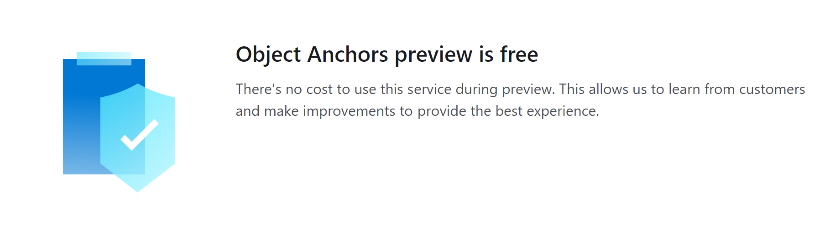
Pricing - West europe

Slide 38
Remote rendering
Notes:
Abstract concept → Examples and scenarios we see with our customers
HL since 2015 → Dozens of apps / use cases
Due to NDA generalized use cases we see commonly

Slide 39
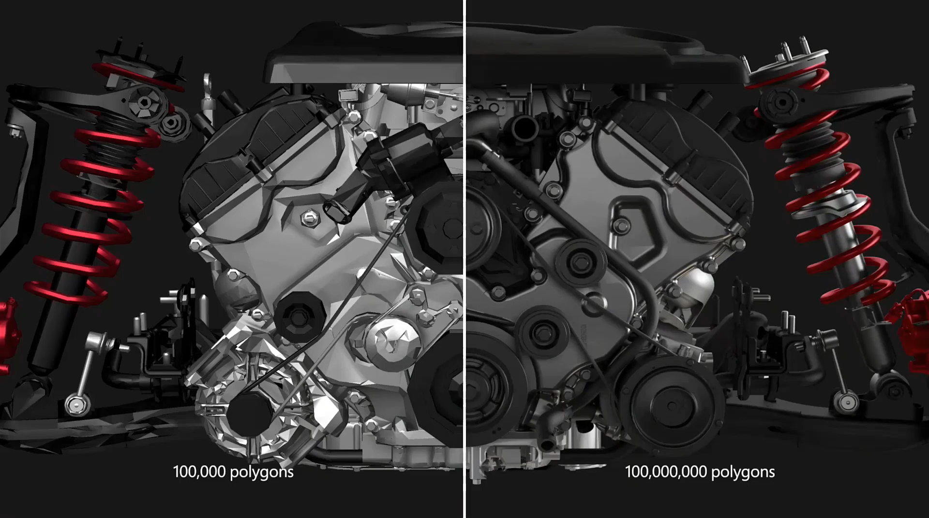
Notes:
Azure Remote Rendering (ARR) is a service that enables you to render high-quality, interactive 3D content in the cloud and stream it in real time to devices, such as the HoloLens 2.

Slide 40
Hybrid rendering
In most applications, it is not sufficient to only render a complex model. You also need custom UI to provide functionality to the user. Azure Remote Rendering does not force you to use a dedicated UI framework, instead it supports Hybrid Rendering. This means you can render elements on device, using your preferred method, such as MRTK.
At the end of a frame, Azure Remote Rendering then automatically combines your locally rendered content with the remote image. It is even able to do so with correct occlusion.

Slide 41
Multi-GPU rendering
Some models are too complex to render at interactive frame rates, even for a high-end GPU. Especially in industrial visualization this is a common problem. To push the limits further, Azure Remote Rendering can distribute the workload to multiple GPUs. The results are merged into a single image, making the process entirely transparent to the user.

Slide 42
Demo
Notes:
Abstract concept → Examples and scenarios we see with our customers
HL since 2015 → Dozens of apps / use cases
Due to NDA generalized use cases we see commonly

Slide 43
Pricing - West europe
Operation | Price | Details
Standard Remote Rendering | €6.210/hour | Standard Remote Rendering provides at least 8 teraflops of graphics computing power and can render scenes up to a maximum of 20 million polygons.
Premium Remote Rendering | €32.398/hour | For larger scenes, Premium Remote Rendering offers at least 42 teraflops of graphics computing power and can render scenes up to hundreds of millions of polygons or more.
Asset Conversion | 100 transactions free per month €0.779/asset | Asset Conversion is required once for each 3D model you want to render. This process converts your source FBX or GLTF file into a format that is optimized for remote rendering.

Slide 44
Domande?
Notes:
Abstract concept → Examples and scenarios we see with our customers
HL since 2015 → Dozens of apps / use cases
Due to NDA generalized use cases we see commonly

Slide 45
Grazie a tutti
Notes:
Abstract concept → Examples and scenarios we see with our customers
HL since 2015 → Dozens of apps / use cases
Due to NDA generalized use cases we see commonly

Slide 46
Alessio Iafrate
Freelance developer – Microsof MVP
alessioiafrate@hotmail.com
alessio-iafrate
@alessioiafrate

